Slide 1
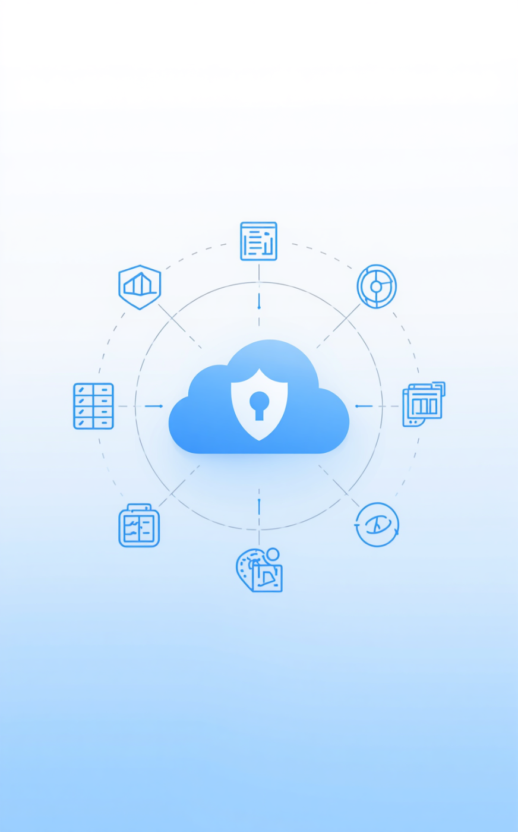

UNIVERSITI TEKNOLOGI MALAYSIA
Secure Cloud-Based Patient Data
Mohamed Omar Mohamed Gad Makhlouf

Slide 2
Presentation Overview
Chapters 3 and 4
This presentation discusses the selection of methodologies and the detailed analysis of requirements and design, providing insights into the system's architecture, security measures, and implementation strategies.

Slide 3
Methodology Selection
Evaluating Best Practices
Waterfall Methodology
Scrum Methodology
Agile DevSecOps
The Waterfall model is a linear approach, making it rigid and unsuitable for evolving security requirements, limiting adaptability and responsiveness to change throughout the development process.
While Scrum offers iterative development, its structure lacks built-in security integration, potentially leaving critical vulnerabilities unaddressed during each sprint and impacting overall system security robustness.
Agile DevSecOps is the chosen methodology, integrating security into every stage of development, ensuring continuous compliance, and allowing for adaptive security measures that evolve alongside changing project needs.

Slide 4
Methodology Comparison
Iterative Development Insights
Security Integration
Iterative Approach
Comparative Analysis
Security integration is crucial in Agile DevSecOps, ensuring that security measures are embedded throughout the development lifecycle, reducing vulnerabilities and enhancing overall system resilience effectively.
An iterative approach allows for continuous feedback, enabling teams to adapt to changing requirements while maintaining focus on delivering secure and high-quality solutions during every development phase.
A comparative analysis of methodologies shows that while Waterfall lacks flexibility and built-in security, Agile DevSecOps uniquely addresses both iterative development and strict security requirements effectively.

Slide 5
Five-Sprint Structure
Sprint Planning
Security Gates
Each sprint starts with a detailed planning session to outline tasks, objectives, and security gates for the upcoming stages.
Security gates ensure that every sprint meets compliance, conducting necessary reviews and tests to maintain system integrity throughout development.
Sprint Iterations
Continuous Evaluation
The five sprints focus on essential components, including architecture, application layers, and security evaluations, to ensure systematic progression.
Regular evaluations during each sprint allow for immediate adjustments, ensuring that security measures remain effective and aligned with project objectives.

Slide 6
Technology Stack
AWS Infrastructure
Infrastructure as Code
AWS provides a robust cloud infrastructure, offering services like EC2, RDS, and ALB for scalable application deployment and management.
Terraform allows for declarative infrastructure management, enabling automated provisioning and configuration of cloud resources in a consistent manner.
Containerization
CI/CD Tools
Docker encapsulates applications within containers, ensuring consistency across environments and simplifying deployment and scaling processes for the application.
GitHub Actions automates the software development lifecycle, enabling seamless integration and delivery pipelines that enhance deployment efficiency and accuracy.
Security Automation
Database Management
Tools like Trivy and SonarQube integrate into the pipeline to automatically scan for vulnerabilities and enforce security best practices throughout development.
PostgreSQL, as a relational database, ensures reliable data storage with advanced features like row-level security and automated backups for data protection.

Slide 7
Use Case Overview
Doctor Role
The doctor can view assigned patients, create, update medical records, and access medical histories and appointments efficiently through the system.
Exploring Doctor, Admin, and Patient Roles and Interactions
Admin Role
The admin manages patient registrations, schedules appointments, and oversees user accounts while ensuring system integrity and patient privacy.
Patient Role
Patients can view their own medical records and appointments in a read-only format, promoting transparency and patient engagement in their care.

Slide 8
AWS Three-Tier Architecture
Presentation Tier
Application Tier
The Presentation Tier utilizes a React frontend, served by an Application Load Balancer, ensuring accessibility and responsive user experiences.
Node.js Express applications run on EC2 instances within private application subnets, providing a secure environment for processing requests and data management.
Data Tier
High Availability
PostgreSQL databases are hosted on Amazon RDS within isolated subnets, ensuring high availability and security with no direct internet access.
The architecture consists of six subnets across two Availability Zones, enhancing reliability and ensuring operational continuity during failures.

Slide 9
Network Security Design
Defense-in-Depth
Security Groups
Defense-in-depth implements layers of security controls to protect data, providing multiple barriers against potential threats and vulnerabilities.
Security groups act as virtual firewalls, controlling traffic to resources, allowing only desired connections while blocking all unsolicited access.
NACLs
Isolation Measures
Network Access Control Lists (NACLs) manage traffic at the subnet level, providing an additional layer of security through stateless rules.
Isolating sensitive components ensures that critical systems, such as databases, remain secure from external access, reducing the risk of data breaches.

Slide 10
Security Design
Layer 1: JWT
JWT Authentication ensures secure user login and session management, utilizing bcrypt hashing for password protection and account lockout mechanisms.
Implementing a Robust Three-Layer RBAC Framework
Layer 2: Application RBAC
Application RBAC middleware validates user roles via JWT on every API call, returning HTTP 403 status for unauthorized access attempts.
Layer 3: PostgreSQL RLS
PostgreSQL Row-Level Security enforces strict data isolation at the storage layer, preventing unauthorized access regardless of application logic or behavior.

Slide 11
DevSecOps Pipeline
Code Checkout
SAST Scan
The pipeline begins with code checkout and dependency installation, ensuring all necessary components are ready for the build process.
A SonarQube SAST scan is performed to identify critical blocker findings, preventing vulnerabilities from entering the codebase early.
Docker Build
Container Image Scan
The next stage involves building the application image using Docker, packaging all dependencies for a consistent runtime environment.
A Trivy container image scan checks for critical CVEs, ensuring the application image is secure before deployment to production.
IaC Scan
Terraform Apply
The infrastructure as code (IaC) scan with Checkov checks for policy violations, blocking the pipeline for any high or critical issues.
Finally, the Terraform Apply stage is executed only after all preceding scans pass, ensuring secure and compliant infrastructure deployment.

Slide 12
Database Schema
Users Table
Patients Table
The users table stores unique identifiers, user roles, and authentication credentials for secure access management.
The patients table contains patient-specific information, including demographic data and medical histories, ensuring comprehensive record-keeping.
Doctors Table
Records Table
The doctors table maintains profiles of healthcare professionals, linking them to their assigned patients and specialties for efficient management.
The records table captures medical records, treatment histories, and notes for each patient, ensuring easy retrieval and compliance with regulations.
Appointments Table
Audit Log
The appointments table tracks scheduled visits, cancellations, and updates, facilitating effective patient-doctor interaction and time management.
The audit log records all user actions, providing a transparent trail for compliance and security monitoring throughout the system.

Slide 13

HIPAA Compliance Overview
01
02
03
04
Access control enforced through RBAC middleware and PostgreSQL RLS policies.
Audit controls implemented via an audit log and AWS CloudTrail integration.
Encryption for data at rest and in transit using KMS and TLS.
Authentication strengthened by bcrypt hashing and account lockout mechanisms.

Slide 14
Interface Design
The Interface Design includes the following components:
Login Screen: Single entry point for all roles, with JWT handling redirection to the appropriate dashboard.
Doctor Dashboard: Displays assigned patient list and today's appointments, along with actions for viewing records and creating new entries.
Admin Dashboard: Features an upcoming appointments table with functionalities to edit, cancel, and quick register new patients, without exposing any medical record content.
Patient Portal: Offers a read-only timeline of medical records, ensuring no create, edit, or delete controls are available for enhanced data security.

Slide 15
Chapter Summary
Key Concepts and Findings
This presentation detailed Agile DevSecOps methodology, three-tier architecture, and robust security measures, ensuring full HIPAA compliance. The system is now ready for implementation in the PSM2 phase.

Slide 16

Any questions or feedback?
Thank you for your attention today!

